Slide 1
Memory Management
CS 3100 Operating Systems
Week 8, Chapter 8: Supplemental Materials

Slide 2
Reasons for Memory Management
Memory must be subdivided to accommodate multiple processes
Memory needs to be allocated efficiently to pack as many processes into memory as possible

Slide 3
Memory Management Requirements
Relocation
  Programmer does not know where the program will be placed in memory when it is executed because…
  While the program is executing, it may be swapped out to disk and returned to main memory at a different location
  Logical Memory references in the code must be translated by the OS to physical memory addresses.

Slide 4
Memory Management Requirements
Protection
  Processes should not be able to reference memory locations in another process without permission
  Therefore, it’s impossible to check absolute addresses in programs since the program could be relocated at any time
  So, memory must be checked during runtime by the Processor (Hardware).
    Operating system cannot anticipate all of the memory references a program will make.

Slide 5
Memory Management Requirements
Sharing
  Allow several processes to access the same portion of memory
  Better to allow each process (person) access to the same copy of the program rather than have their own separate copy

Slide 6
Memory Management Requirements
Logical Organization
  Memory is Linear, but
  Programs are written in modules
  Advantages achieved:
  Modules can be shared among processes
  Modules can be written and compiled independently – resolving memory references at runtime
  Different degrees of protection given to modules (read-only, execute-only)

Slide 7
Memory Management Requirements
Physical Organization
  Memory available for a program plus its data may be insufficient
  Programmer does not know how much space will be available
    Overlaying allows various modules to be assigned the same region of memory
  Moving seamlessly between memory locations is the key to Effective Memory Management

Slide 8
Allocating Processes to Memory: Dynamic Loading
Routine is not loaded until it is called
Better memory-space utilization; unused routines are never loaded.
Useful when large amounts of code are needed to handle infrequently occurring cases.
No special support from the operating system is required; implemented through program design.

Slide 9
Allocating Processes to Memory: Dynamic Linking Libraries (DLL’s)
Linking postponed until execution time.
Small piece of code, called a stub, is used to locate the appropriate memory-resident library routine.
Stub replaces itself with the address of the routine, and executes the routine.
Operating system needed to check if routine is in processes’ memory address.
Libraries can be easily updated.

Slide 10
Allocating Processes to Memory: Overlays
Keep in memory only those instructions and data that are needed at any given time.
Needed when process is larger than amount of memory allocated to it.
Implemented by user, no special support needed from operating system, programming design of overlay structure is complex.

Slide 11
Allocating Processes to Memory: Swapping
A process can be swapped temporarily out of memory to a backing store, and then brought back into memory for continued execution.
Backing store – fast disk large enough to accommodate copies of all memory images for all users; must provide direct access to these memory images.
Must be fast enough to keep up with CPU Scheduler demands.

Slide 12
Swapping (cont)
Roll out, roll in – swapping variant used for priority-based scheduling algorithms; lower-priority process is swapped out so higher-priority process can be loaded and executed (next Chapter).
Major part of swap time is transfer time; total transfer time is directly proportional to the amount of memory swapped.
Modified versions of swapping are found on many systems, i.e., UNIX and Microsoft Windows.

Slide 13
Contiguous Memory Allocation
Main memory usually into two partitions:
  Resident operating system, usually held in low memory with interrupt vector.
  User processes then held in high memory.
Single-partition allocation
  Relocation-register scheme (with the help of Memory Management Unit – MMU) used to protect user processes from each other, and from changing operating-system code and data.
  Relocation register contains value of smallest physical address; limit register contains range of logical addresses – each logical address must be less than the limit register.

Slide 14
Contiguous Allocation (cont)
Multiple-partition allocation
  Hole – block of available memory; holes of various size are scattered throughout memory.
  When a process arrives, it is allocated memory from a hole large enough to accommodate it.
  Only as much memory as is needed is allocated to the process.

Slide 15
Contiguous Allocation (cont)
  Operating system maintains information about:
    allocated partitions
    free partitions (hole)
OS
OS
OS
OS
process 5
process 5
process 5
process 5
process 9
process 9
process 8
process 10
process 2
process 2
process 2
process 2

Slide 16
Fixed Partitioning Philosophy
Equal-size partitions
  any process whose size is less than or equal to the partition size can be loaded into an available partition
  if all partitions are full, the operating system can swap a process out of a partition
  because all partitions are of equal size, it does not matter which partition is used

Slide 17
Fixed Partitioning Difficulties
Main memory use is inefficient. Any program, no matter how small, occupies an entire partition. This is called internal fragmentation.
a program may not fit in a partition. The programmer must design the program with overlays
Lessened (not solved) by using unequal sized fixed partitioning

Slide 18
Fixed Partitioning – Unequal Partitions
Unequal-size partitions
  can assign each process to the smallest partition within which it will fit
  There is a queue for each partition
  processes are assigned in such a way as to minimize wasted memory within a partition

Slide 19
Dynamic Partitioning
Partitions are of variable length and number
Process is allocated exactly as much memory as required
Eventually get holes in the memory. This is called external fragmentation
Must use compaction to shift processes so they are contiguous and all free memory is in one block

Slide 20
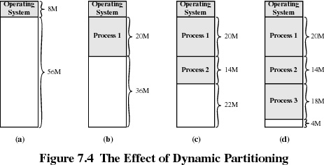

Slide 21
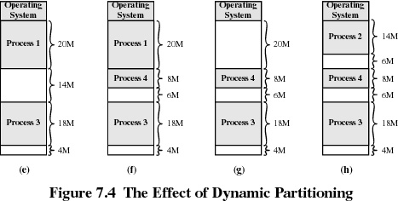

Slide 22
Dynamic Partitioning Placement Algorithms
Operating system must decide which free block to allocate to a process (how to plug the holes)
1. First-fit algorithm
  Searches from the beginning of the memory block
  Fastest algorithm, but
  May have many processes loaded in the front end of memory that must be searched over when trying to find a free block

Slide 23
Dynamic Partitioning Placement Algorithm
2. Best-fit algorithm
  Chooses the block that is closest in size to the request
  Since smallest block is found for process, the smallest amount of fragmentation is left, but memory compaction must be done more often

Slide 24
Dynamic Partitioning Placement Algorithm
Worse-fit algorithm
  Scans memory from the last known location through the end and allocates the largest hole
  More often allocates a block of memory at the end of memory where the largest block is found
  The largest block of memory is eventually broken up into smaller blocks
  Compaction is required to obtain a large block at the end of memory

Slide 25
Paging
Partition memory into small equal-size chunks and divide each process into the same size chunks
The chunks of a process are called pages and chunks of memory are called frames
Operating system maintains a page table for each process
  contains the frame location for each page in the process
  memory address consist of a page number and offset within the page

Slide 26
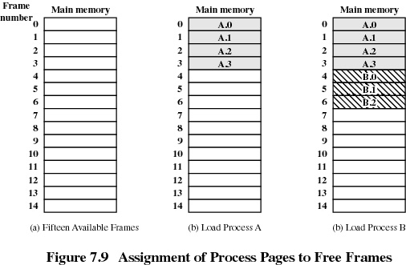

Slide 27
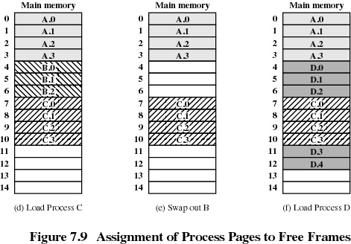

Slide 28
Segmentation
Supports a user view of memory
All segments of all programs do not have to be of the same length
There is a maximum segment length
Addressing consists of two parts - a segment number and an offset
Since segments are not equal, segmentation is similar to dynamic partitioning

